Slide 1
CS35L Week 6 Lecture 2
Rishab Ketan Doshi

Slide 2
Overview
Number systems
Binary
Octal
Decimal
Hexadecimal
Representing -ve numbers on the computer
Signed bit
1s complement
2s complement
Endianness
Pthread example code
Embarrassingly parallel examples
Homework explanation + hints

Slide 3
Number Systems
We are all familiar with decimal numbers.
Ex: 735 = 700 + 30 + 5 = 7×10^2 + 3×10^1 + 5×10^0
In decimal system, the base is 10.
Base is the number(raised to the power) you multiply with for every position in the number.
Base is the number of digits in that number system.

Slide 4
Binary Number System
Binary - Base is 2. Only two digits allowed 0 or 1.
Ex: 101 is a valid binary (base 2) number
Converting binary to decimal:
101 (base 2) = 1 x 2^2 + 0 x 2^1 + 1 x 2^0 = 4 + 0 + 1 = 5 (base 10)

Slide 5
Converting Decimal to Binary

Slide 6
Octal Number System
Octal - Base is 8. Only eight digits allowed 0 – 7 (inclusive).
Ex: 731 is a valid octal (base 8) number
Converting octal to decimal:
731 (base 8) = 7 x 8^2 + 3 x 8^1 + 1 x 8^0 = 473 (base 10)

Slide 7
Converting decimal to octal?
Same remainder technique.
 | Number | Remainder
8 | 650
8 | 81 | 2
8 | 10 | 1
8 | 1 | 2
650(base 10) = 1212(base 8)

Slide 8
Hexadecimal Number System
Octal - Base is 16. Sixteen digits allowed
0 – 9
A – F (A – 10, B – 11, C-12, D-13, E-14, F-15)
Ex: A3E is a valid hexadecimal (base 16) number
Converting hexadecimal to decimal:
A3E (base 16) = 10 x 16^2 + 3 x 16^1 + 14 x 16^0 = 2622 (base 10)

Slide 9
Conversion across base systems
How to convert Base 4 to Base 3
Convert original number to decimal
Use remainder technique to convert decimal number in prev step.
Ex: Convert 1023(base 4) to (base 3)
1023(base 4) = 75 (base 10)
Using remainder with repeated division technique 75(base 10) is 2210(base 3)
Summarizing: 1023(base 4) -> 75(base 10) -> 2210 (base 3)

Slide 10
Computer Memory and Data Representation
n bits can represent – 2^n numbers.
Example. n=3 can have the one of the 8 values:
000, 001, 010, 011, 100, 101, 110, or 111
You could use them to represent numbers 0 to 7, numbers 8881 to 8888, characters 'A' to 'H', or up to 8 kinds of fruits like apple, orange, banana; or up to 8 kinds of animals like lion, tiger, etc
Important to note that a computer memory location merely stores a binary pattern.
It is entirely up to you, as the programmer, to decide on how these patterns are to be interpreted.
For example, the 8-bit binary pattern "0100 0001B" can be interpreted as an unsigned integer 65, or an ASCII character 'A', or some secret information known only to you. In other words, you have to first decide how to represent a piece of data in a binary pattern before the binary patterns make sense.
The interpretation of binary pattern is called data representation or encoding

Slide 11
Interesting Story: Rosette Stone and the Decipherment of Egyptian Hieroglyphs
Egyptian hieroglyphs (next-to-left) were used by the ancient Egyptians since 4000BC.
Unfortunately, since 500AD, no one could longer read the ancient Egyptian hieroglyphs, until the re-discovery of the Rosette Stone in 1799 by Napoleon's troop (during Napoleon's Egyptian invasion) near the town of Rashid (Rosetta) in the Nile Delta.
The Rosetta Stone (left) is inscribed with a decree in 196BC on behalf of King Ptolemy V. The decree appears in three scripts: the upper text is Ancient Egyptian hieroglyphs, the middle portion Demotic script, and the lowest Ancient Greek. Because it presents essentially the same text in all three scripts, and Ancient Greek could still be understood, it provided the key to the decipherment of the Egyptian hieroglyphs.
The moral of the story is unless you know the encoding scheme, there is no way that you can decode the data.

Slide 12
Integer Representation
Computers use a fixed number of bits to represent an integer. The commonly-used bit-lengths for integers are 8-bit, 16-bit, 32-bit or 64-bit. Besides bit-lengths, there are two representation schemes for integers:
Unsigned Integers: can represent zero and positive integers.
Signed Integers: can represent zero, positive and negative integers. Three representation schemes had been proposed for signed integers:
Sign-Magnitude representation
1's Complement representation
2's Complement representation

Slide 13
Unsigned Representation
Unsigned integers can represent zero and positive integers, but not negative integers.
Example 1: Suppose that n=8 and the binary pattern is 0100 0001B, the value of this unsigned integer is 1×2^0 + 1×2^6 = 65D.
Example 2: Suppose that n=16 and the binary pattern is 0000 0000 0000 0000B, the value of this unsigned integer is 0.
An n-bit pattern can represent 2^n distinct integers. An n-bit unsigned integer can represent integers from 0 to (2^n)-1, as tabulated:
n | Minimum | Maximum
8 | 0 | (2^8)-1 (=255)
16 | 0 | (2^16)-1 (=65,535)
32 | 0 | (2^32)-1 (=4,294,967,295) (9+ digits)
64 | 0 | (2^64)-1 (=18,446,744,073,709,551,615) (19+ digits)

Slide 14
Sign-Magnitude representation
In sign-magnitude representation:
The most-significant bit (msb) is the sign bit, with value of 0 representing positive integer and 1 representing negative integer.
The remaining n-1 bits represents the magnitude (absolute value) of the integer. The absolute value of the integer is interpreted as "the magnitude of the (n-1)-bit binary pattern".
Suppose that n=8 and the binary representation is 1 000 0001B. Sign bit is 1 ⇒ negative Absolute value is 000 0001B = 1D Hence, the integer is -1D

Slide 15
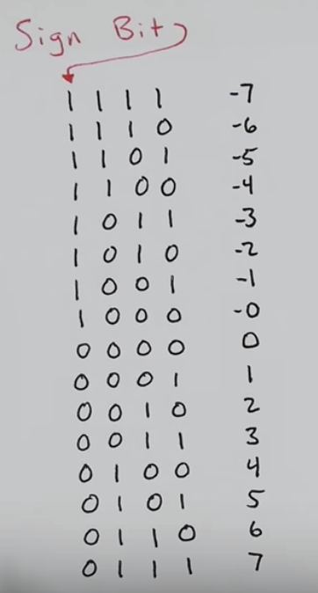
Problems
2 representations for same 0.
+0 and -0
Math doesn’t work out directly
Ex: 5 + (-5)
1 1
0 1 0 1
+ 1 1 0 1
1 0 0 1 0
0010 is not equal to 1000(-0) or 0000(+0)
Carry in green
Discarded bit in red(n=4)
N = 4,
all possible values

Slide 16
1s complement representation
In 1's complement representation:
Again, the most significant bit (msb) is the sign bit, with value of 0 representing positive integers and 1 representing negative integers.
The remaining n-1 bits represents the magnitude of the integer, as follows:
for positive integers, the absolute value of the integer is equal to "the magnitude of the (n-1)-bit binary pattern".
for negative integers, the absolute value of the integer is equal to "the magnitude of the complement (inverse) of the (n-1)-bit binary pattern" (hence called 1's complement).
Examples:
Suppose that n=8 and the binary representation 1 000 0001B. Sign bit is 1 ⇒ negative Absolute value is the complement of 000 0001B, i.e., 111 1110B = 126D Hence, the integer is -126D
Suppose that n=8 and the binary representation 0 100 0001B. Sign bit is 0 ⇒ positive Absolute value is 100 0001B = 65D Hence, the integer is +65D

Slide 17
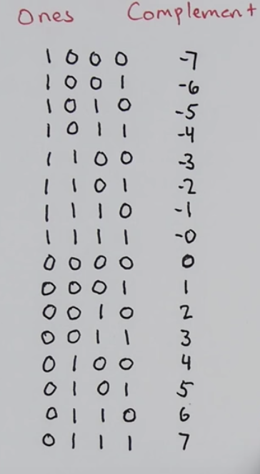
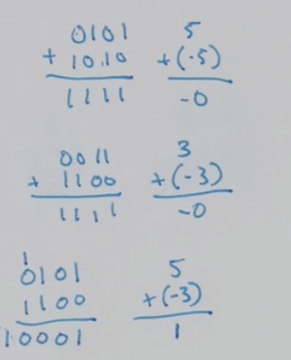
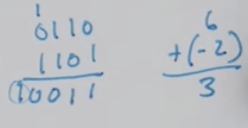
Problems
2 representations for 0 (+0 and -0)
Math still doesn’t work out directly. Specifically, all answers are off by one

Slide 18
2s complement
In 2's complement representation:
Again, the most significant bit (msb) is the sign bit, with value of 0 representing positive integers and 1 representing negative integers.
The remaining n-1 bits represents the magnitude of the integer, as follows:
for positive integers, the absolute value of the integer is equal to "the magnitude of the (n-1)-bit binary pattern".
for negative integers, the absolute value of the integer is equal to "the magnitude of the complement of the (n-1)-bit binary pattern plus one" (hence called 2's complement).
Example 1: Suppose that n=8 and the binary representation 0 100 0001B. Sign bit is 0 ⇒ positive Absolute value is 100 0001B = 65D Hence, the integer is +65D
Example 2: Suppose that n=8 and the binary representation 1 000 0001B. Sign bit is 1 ⇒ negative Absolute value is the complement of 000 0001B plus 1, i.e., 111 1110B + 1B = 127D Hence, the integer is -127D

Slide 19
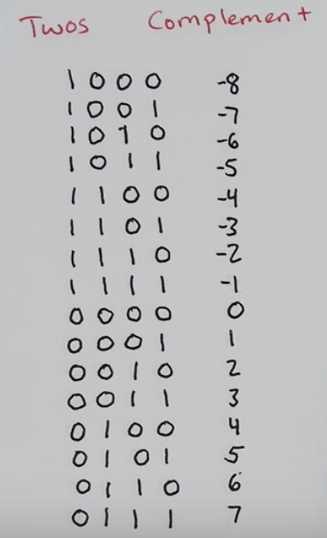
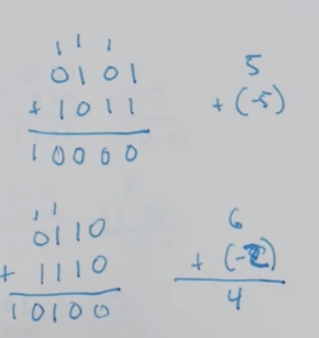
Any problems?
Single representation for 0
Math works out
Sign bit can be thought of as place value of -8 .
Ex:
1001 = 1*(-8) + 0*(4) + 0*(2) + 1*(1) = -7

Slide 20
Endianness
Modern computers store one byte of data in each memory address or location, i.e., byte addressable memory. An 32-bit integer is, therefore, stored in 4 memory addresses.
The term"Endian" refers to the order of storing bytes in computer memory. In "Big Endian" scheme, the most significant byte is stored first in the lowest memory address (or big in first), while "Little Endian" stores the least significant bytes in the lowest memory address.
For example, the 32-bit integer 12345678H (305419896₁₀) is stored as 12H 34H 56H 78H in big endian; and 78H 56H 34H 12H in little endian. An 16-bit integer 00H 01H is interpreted as 0001H in big endian, and 0100H as little endian.

Slide 21
Pthread examples
Run examples from https://github.com/rishabkdoshi/CS35L/blob/master/week6/learningByDoing/pthreads.md

Slide 22
Ray Tracing
An advanced computer graphics technique for rendering 3D images
Mimics the propagation of light through objects
Simulates the effects of a single light ray as it’s reflected or absorbed by objects in the images

Slide 23

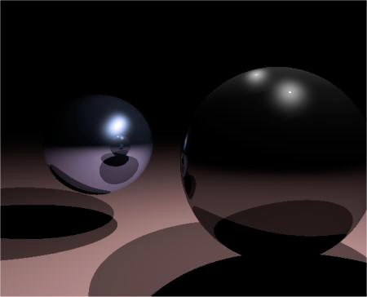
Without ray tracing
With ray tracing

Slide 24
Computational Resources
Ray Tracing produces a very high degree of visual realism at a high cost (yields high quality rendering)
The algorithm is computationally intensive
Good candidate for multithreading (embarrassingly parallel)
Threads need not synchronize with each other, because each thread works on a different pixel

Slide 25
Homework Steps
You have a single threaded program, you need to implement a multi-threaded version
Understand what makefile is doing
Read code, starting from main function in main.c
Don’t change any functions in any files
This should help you narrow down places to look for changes
This task of ray tracing is embarrassingly parallel
Identify which part of code has to be parallelized
Identify which variables need to be made global or passed to your thread function

Slide 26
Presentations

Slide 27
References:
https://www.youtube.com/watch?v=4qH4unVtJkE
https://www3.ntu.edu.sg/home/ehchua/programming/java/datarepresentation.html

